Slide 1
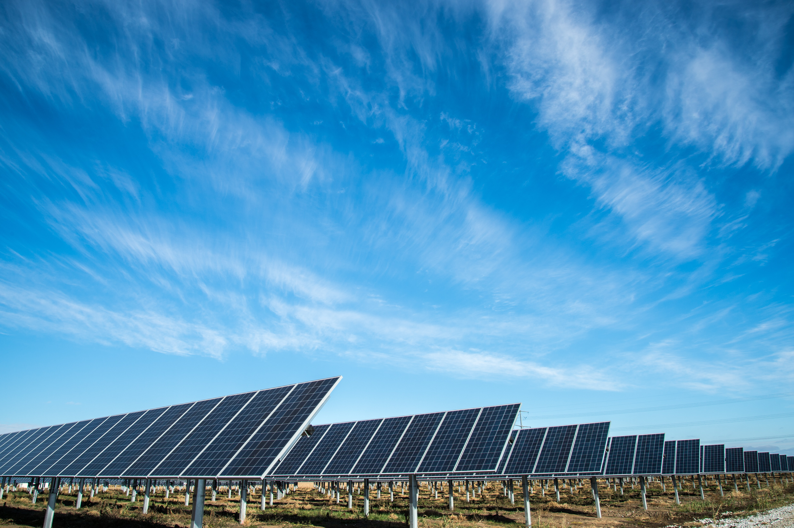
Dwelling Energy Insights
Team members: Merel Kreszner, Olivier van Luijk, Rajeev Kalloe, Santiago Puertas Puchol, Emilio Caba Batuecas & Teo Čurčić
Project Owner: Dr. ir. T.B. Salcedo Rahola

Slide 2
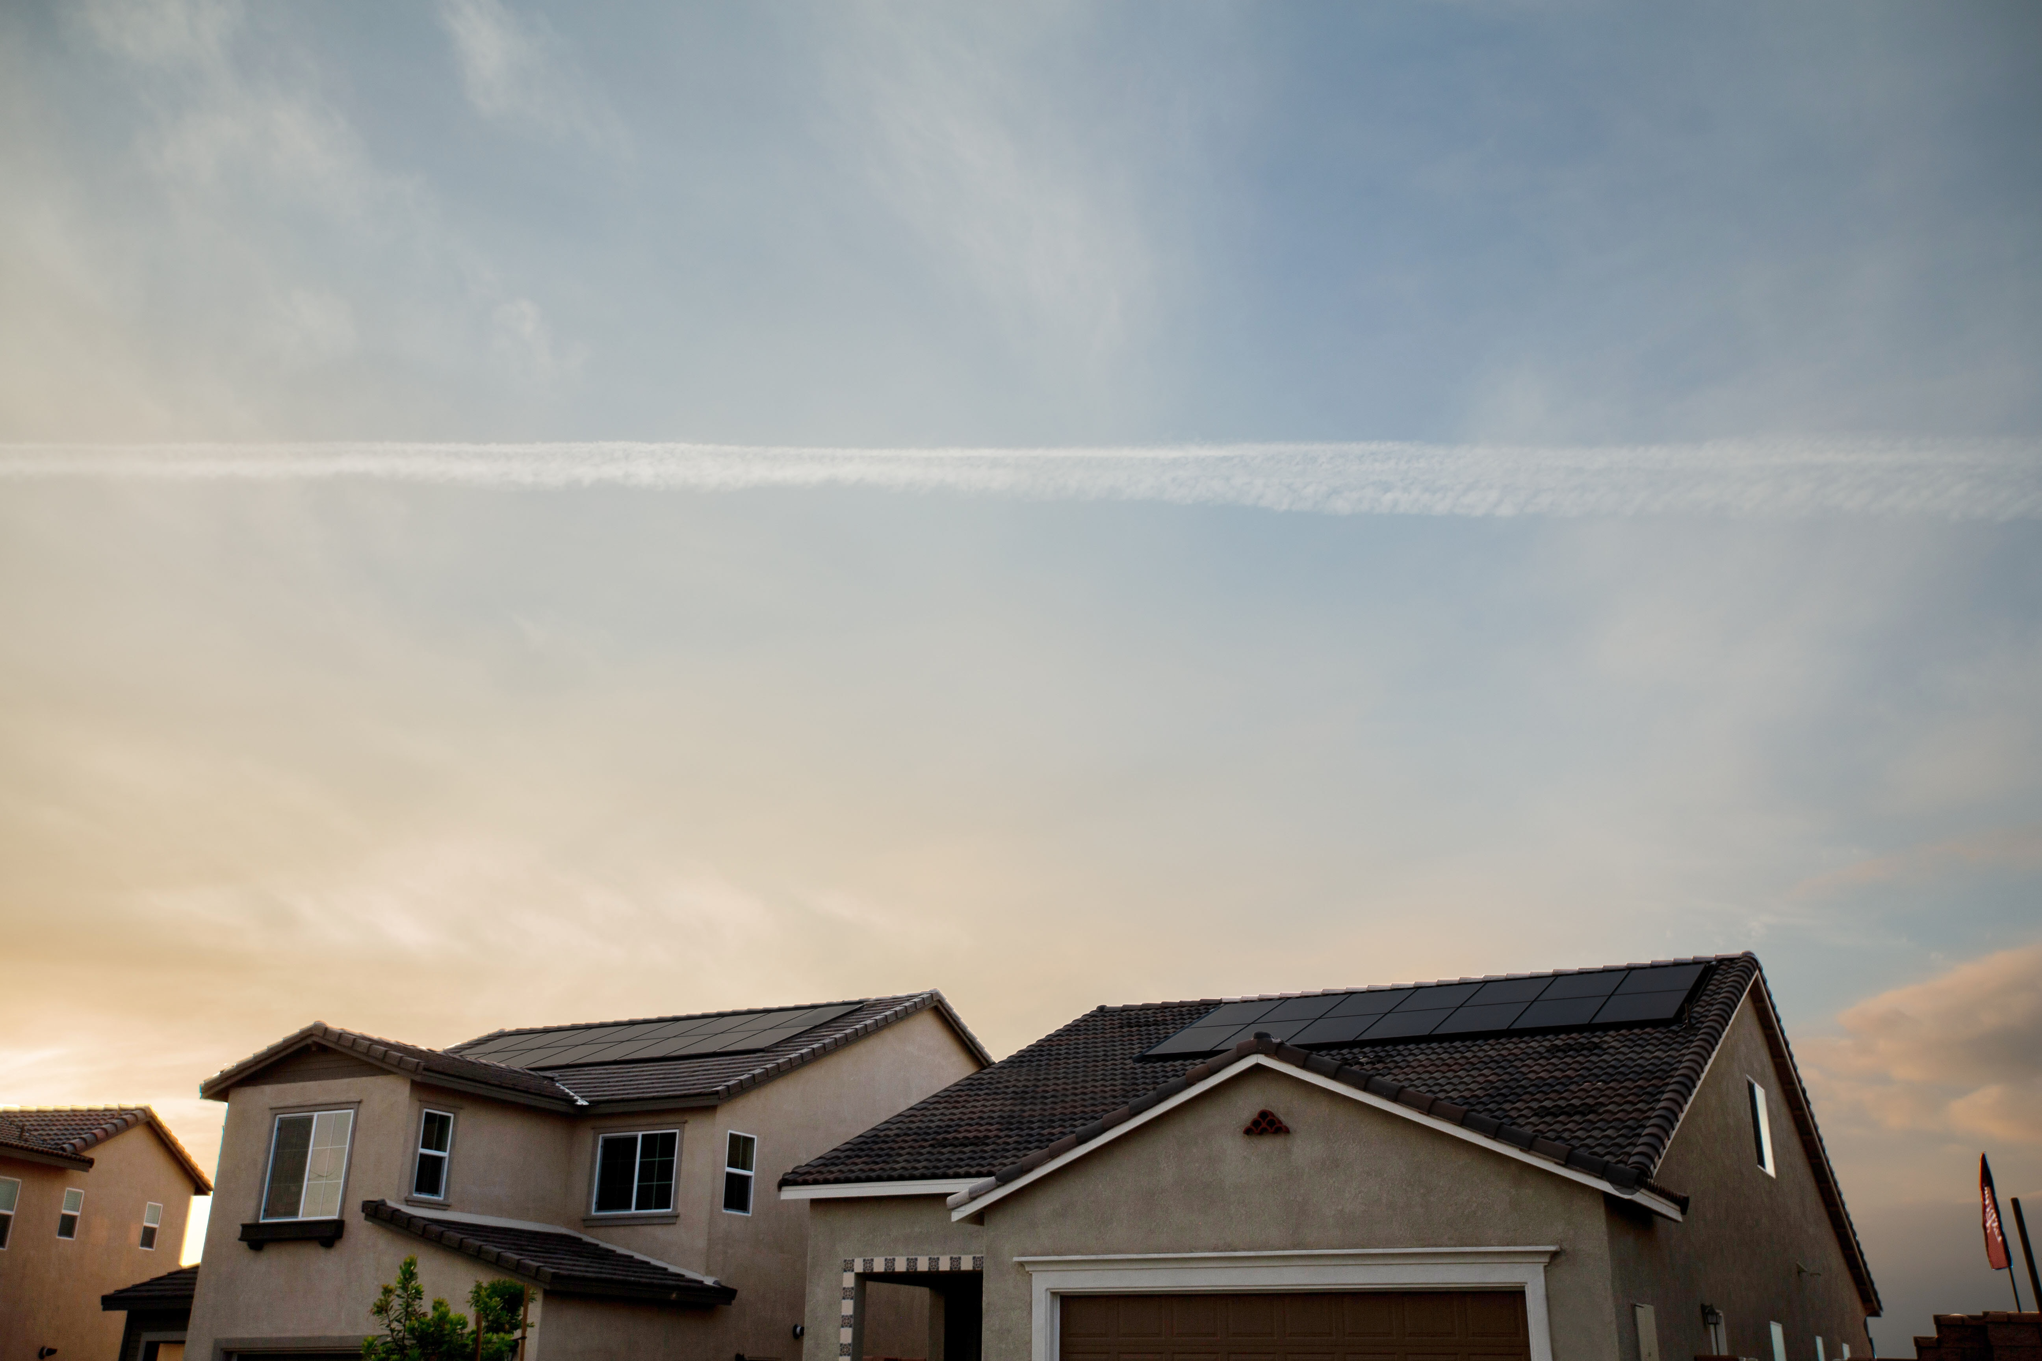
Table of Contents
Project information
Performed steps so far
First visualizations using the original data
Data cleaning process
Data Analysis
Implementing models
Looking forward

Slide 3
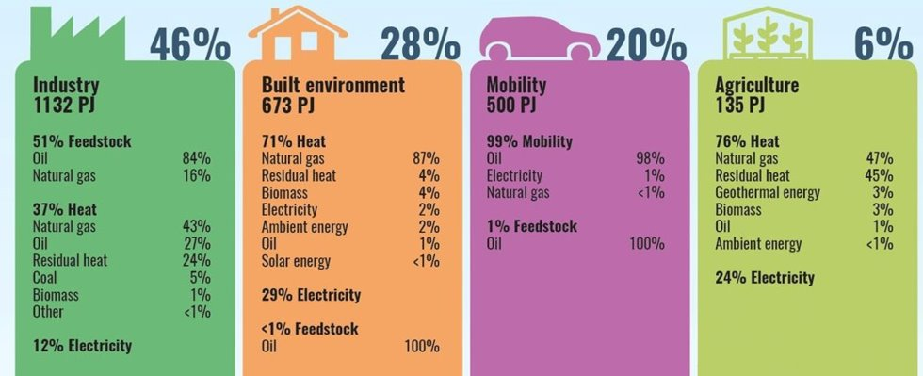
Project information: National energy usage
Notes:
The use of natural gasses can be highly reduced by using electricity (for example by using solar panels), possibly to 0%.

Slide 4
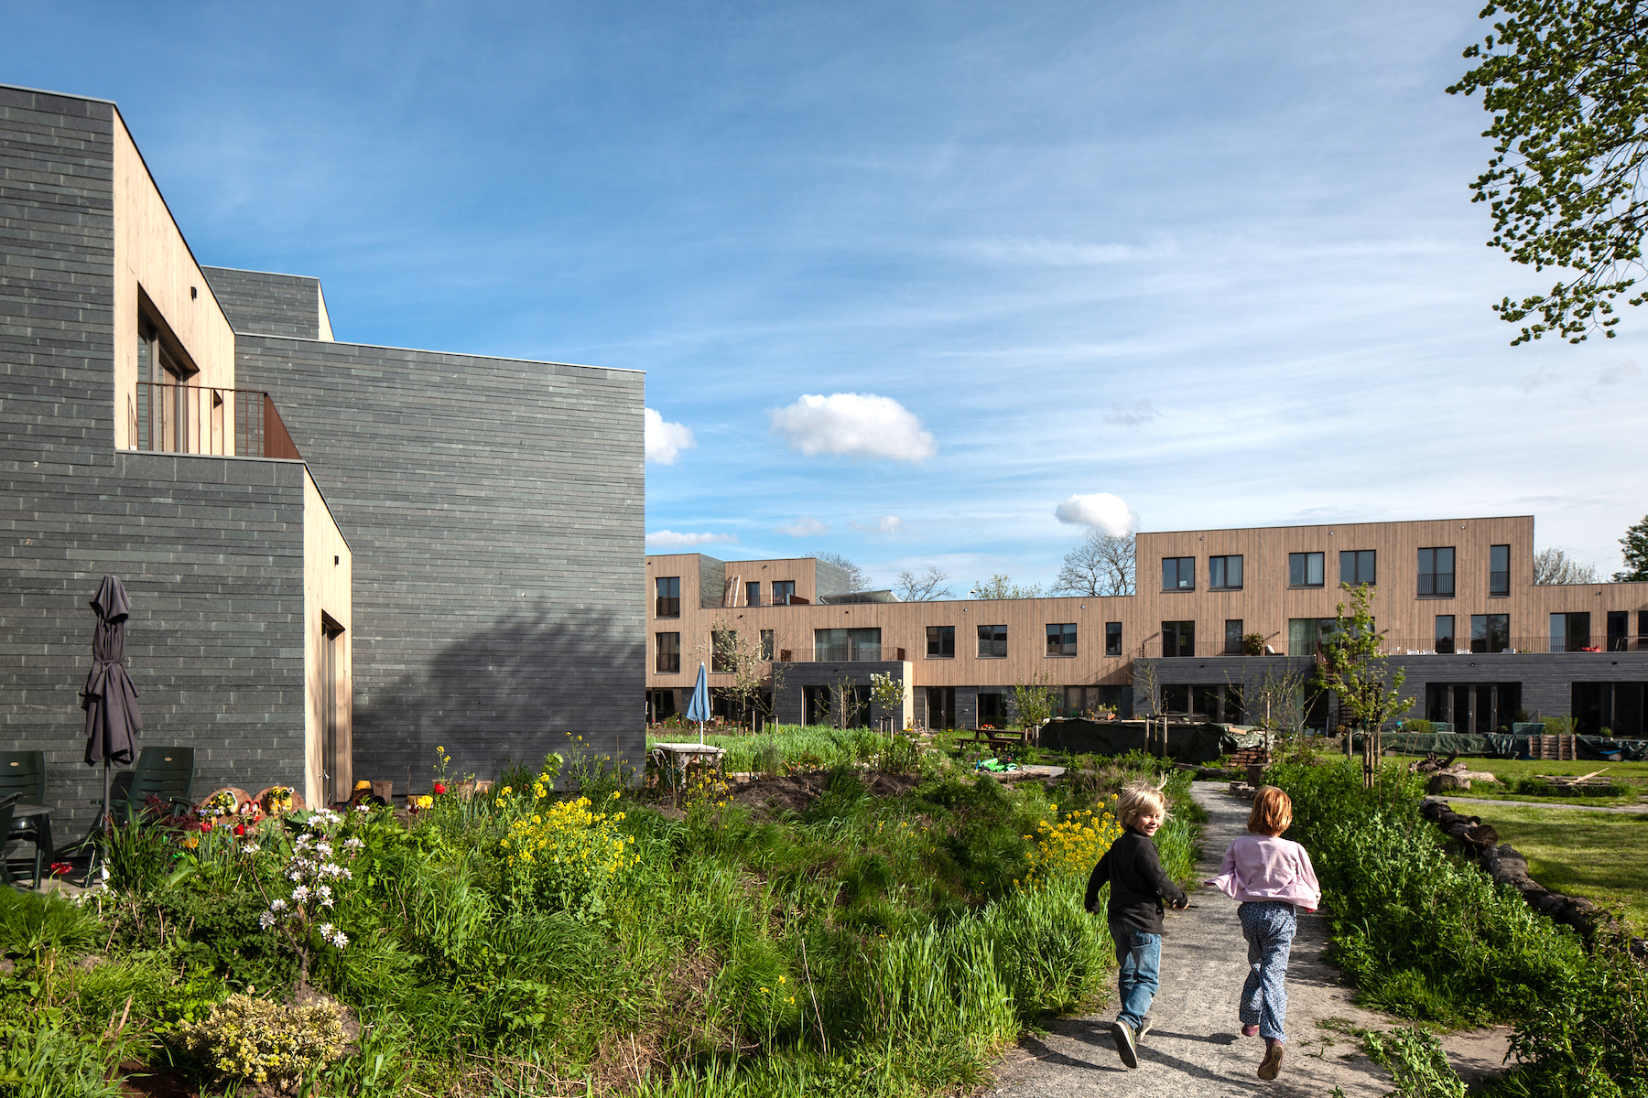
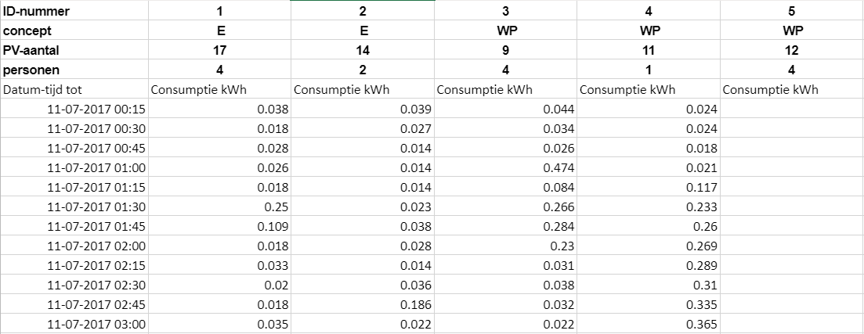
Project information: Dataset
Notes:
Smart meters allow us to get information about the energy usage of a house.
Using this information, we can determine the dwelling characteristics and the use behaviour.
This information can be used to optimize the energy system and to propose possible improvements to it with the goal to reduce CO2 emissions.
Labels:
Concept (the way a house is heated):
E = Electricity
WP = Heating Pump
Zon = Solar Panels
PV-aantal = Number of solar panels
Personen = Number of people that live in a house

Slide 5
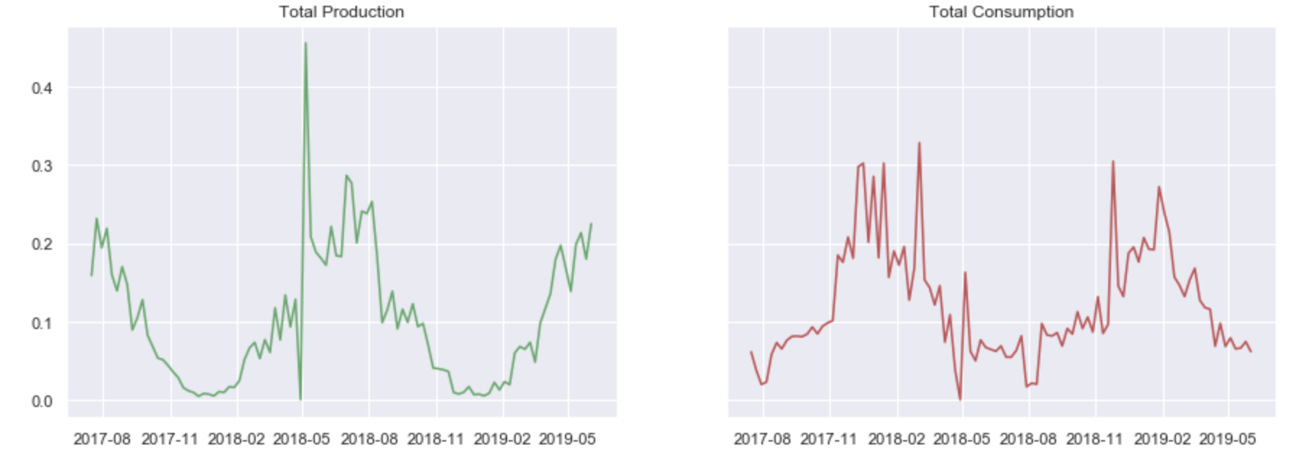
First visualizations: Production/Consumption
Notes:
- Plot the raw data of one house
- Global idea
- Wrong values (outliers) -> Data is sum up

Slide 6
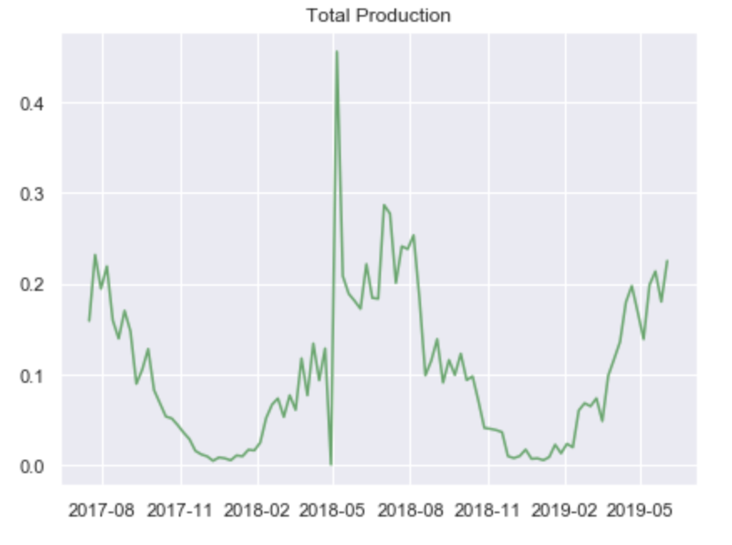
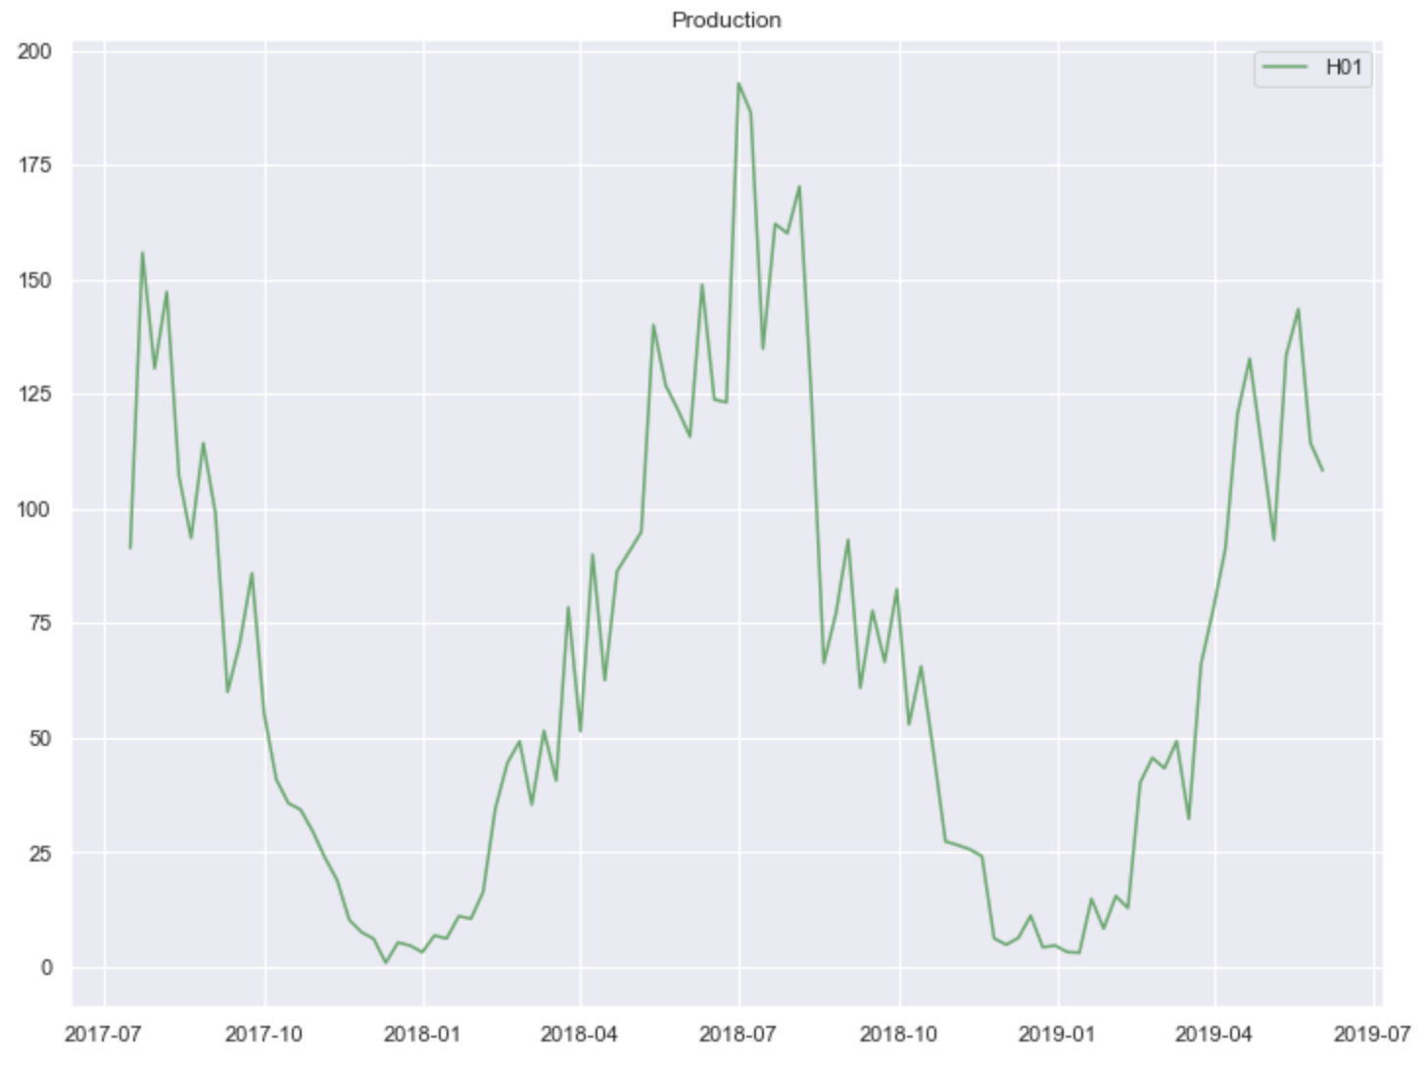
Data cleaning process
Deleting rows with blank spaces.
Deleting outliers.
Notes:
- We have cleaned the data
- This cleaning allow us to get better insight of the energy production

Slide 7
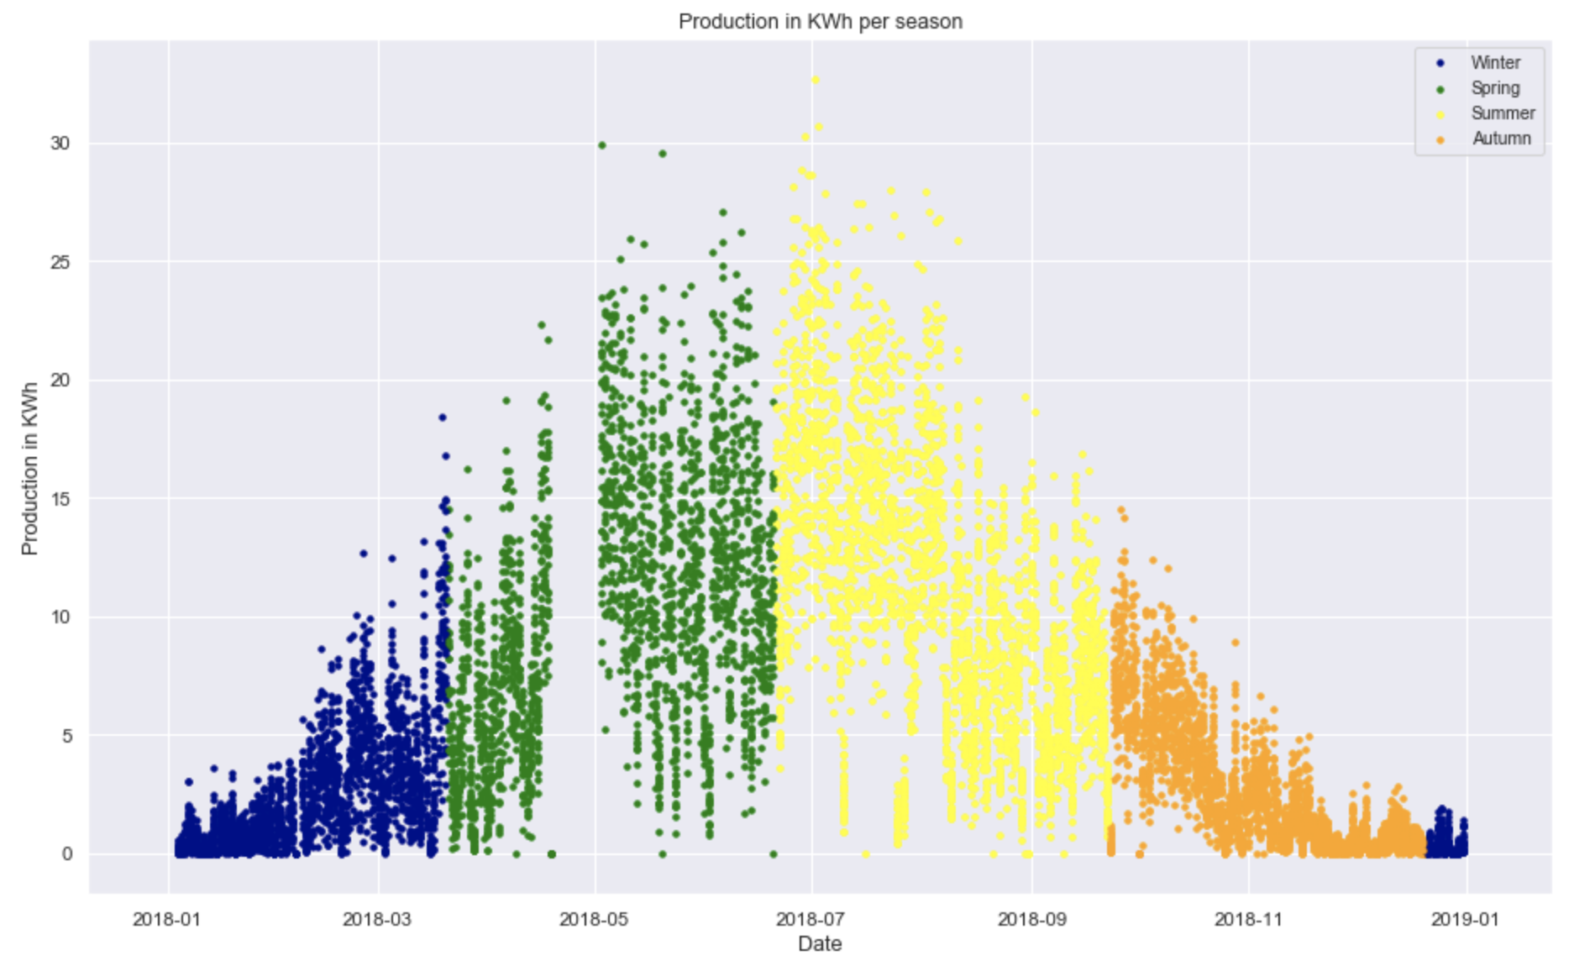
Cleaned Data: Production
Notes:
- Plot of all houses production
- More production during the summer months because of the daylight hours

Slide 8
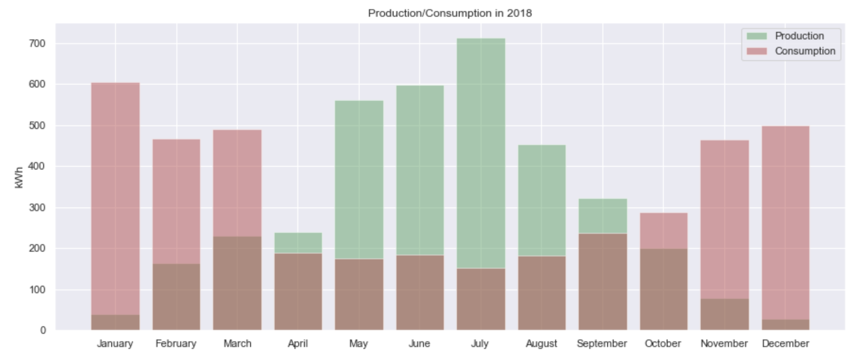
House 1 Production and Consumption
Notes:
- Against the previous graph
- House number 1
- 6 months of consumption
- 6 months of production

Slide 9
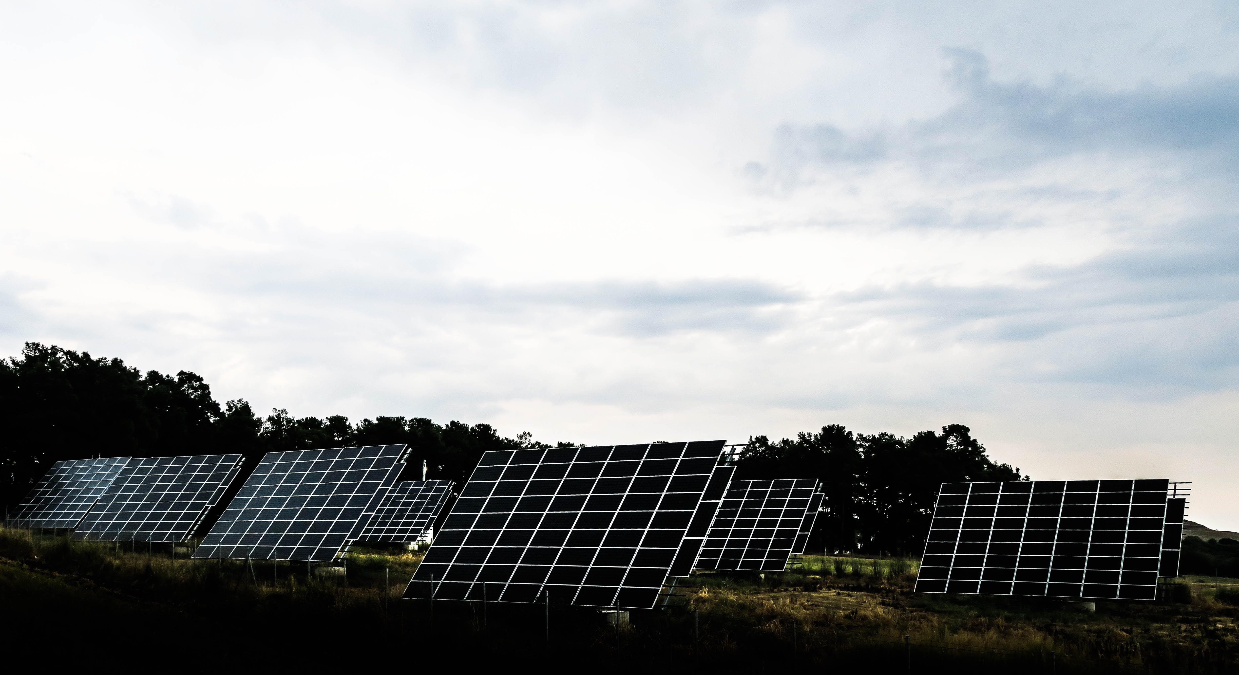
Data Analysis
What is the maximum usage/production per day per household?
What is the maximum amount of Ampere that a household delivers?

Slide 10
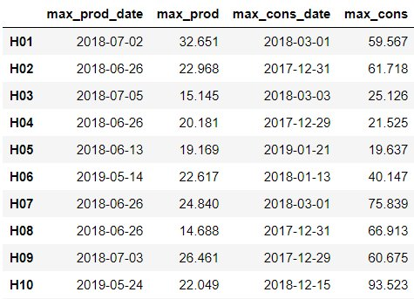
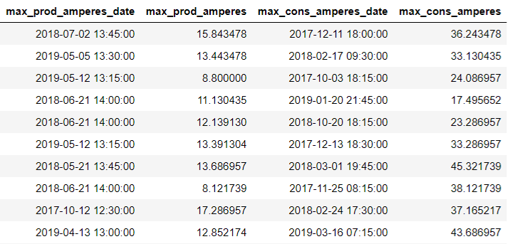
Data Analysis - Results
Notes:
- Left: Day of maximum production
- Right: Exact moment of the maximum production (amperes)
- Get more insight and could be useful in the future

Slide 11
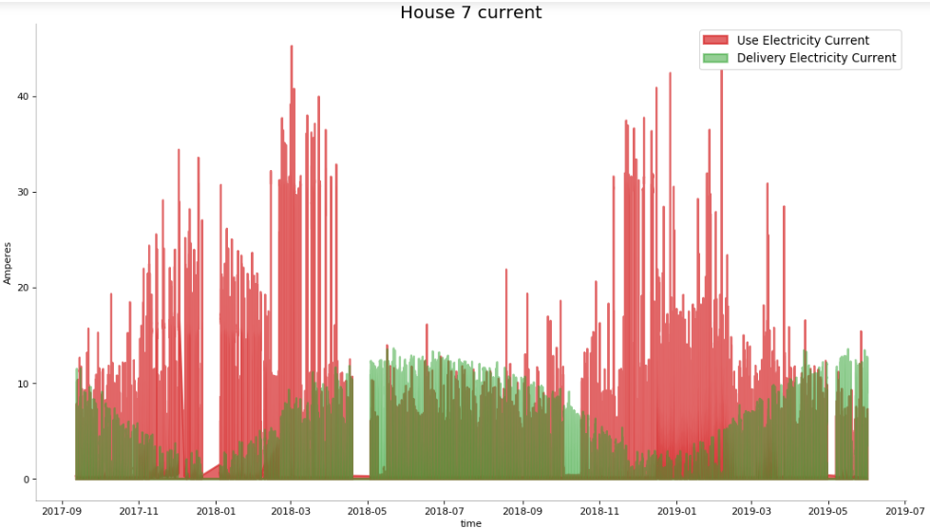
Data Analysis - Results

Slide 12
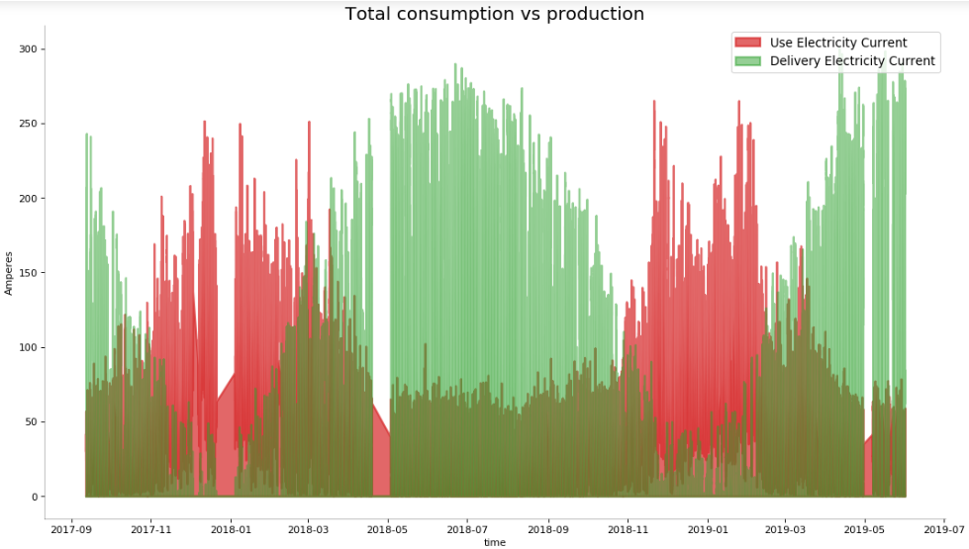
Data Analysis - Results

Slide 13
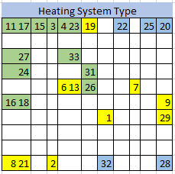
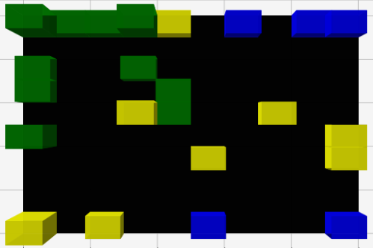
What kind of groups can we produce based on the dwelling characteristics?
Notes:
Showing up the different algorithm results

Slide 14
Looking forward
Improving our models.
Comparing all the models with each other.
Look for consumption behaviour patterns.

Slide 15
Questions/Feedback
Are there any questions or feedback based on this presentation?

Slide 16
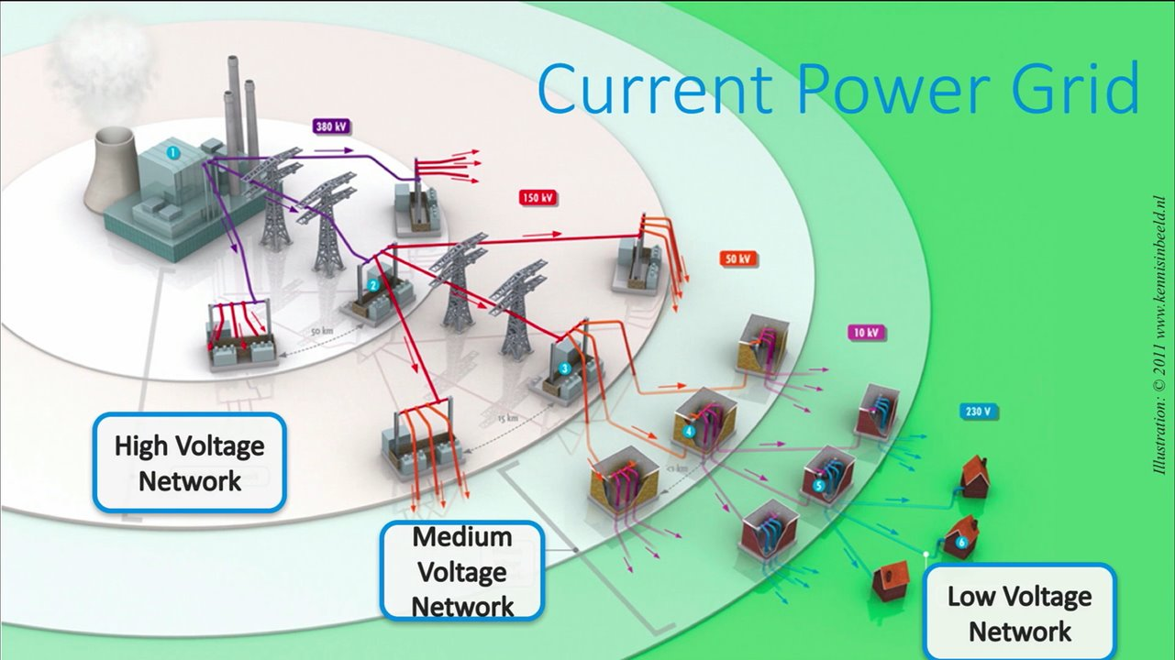
Introduction to the main topic
Notes:
All energy comes from one generation point
Generation and consumption happen in different places.
Goes from one point to smaller points

Slide 17
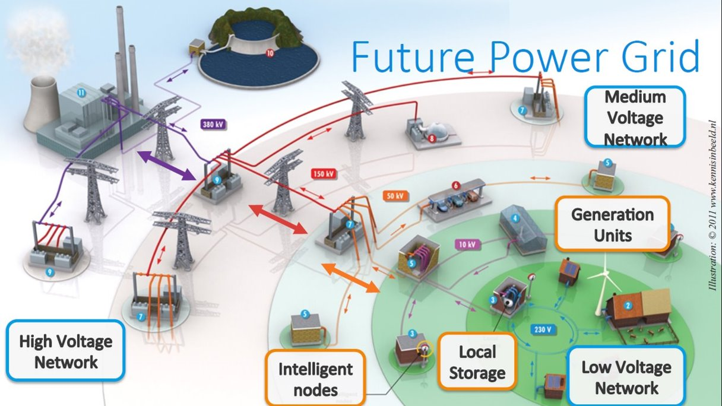
Project information: National energy usage
Notes:
Generation and consumption can happen at the same place.
Storage is very important; left over energy is stored in the Local Storage.
We have generation units, such as solar panels or windmills.
We are dealing with different scales; if more energy is needed, we move a scale. In the worst case, the High Voltage Network is used. Ofcourse we prefer to use the High Voltage Network as little as possible.

